Slide 1
Cardiovascular system
Anatomy and physiology, pathology, diagnostic procedures, pharmacology, medical procedures.

Slide 2
The cardiovascular system functions in coordination with the pulmonary system to circulate oxygenated blood through the arterial system to all cells. The deoxygenated blood is then collected from the venous system and delivered to the lungs for reoxygenation.
Cardinal symptoms of cardiac disease usually include chest, neck, or arm pain or discomfort; palpitations (noticeably strong, rapid or irregular heartbeat); dyspnea (difficulty of breathing); syncope (fainting); fatigue; cough; and cyanosis (bluish color d/t a shortage of oxygen in the blood).
Edema and leg pain (claudication) are the most common symptoms of the vascular component of cardiovascular pathologic conditions.
Angina is chest pain or discomfort occurring when a heart muscle does not get enough oxygen, and it is a symptom of coronary artery disease (CAD). It usually starts behind the breastbone, but it may project in the arm, shoulder, neck, jaw, throat, and back. Angina is described as pressure, squeezing, or tightness in the chest. Some people may mistake it for indigestion. Shortness of breath, weakness, lightheadedness, and sweating may occur.

Slide 3
Palpitations, the presence of an irregular, fast, or "extra" heartbeat, may also be referred to as arrhythmias or dysrhythmias, which may result from relatively benign causes such as MVP (mitral valve prolapse), caffeine, anxiety, exercise, or athlete’s heart (an increase in left ventricular mass as a result of intensive training) or a severe condition such as CAD, cardiomyopathy, complete heart block, ventricular aneurysm, atrioventricular valve disease, or mitral or aortic stenosis.
MVP video https://youtu.be/Q84DwBABbY0
Dyspnea, also referred to as breathlessness or shortness of breath, can be cardiovascular in origin, but it may also occur secondary to pulmonary pathologic conditions, trauma, fever, certain medications, or obesity.

Slide 4
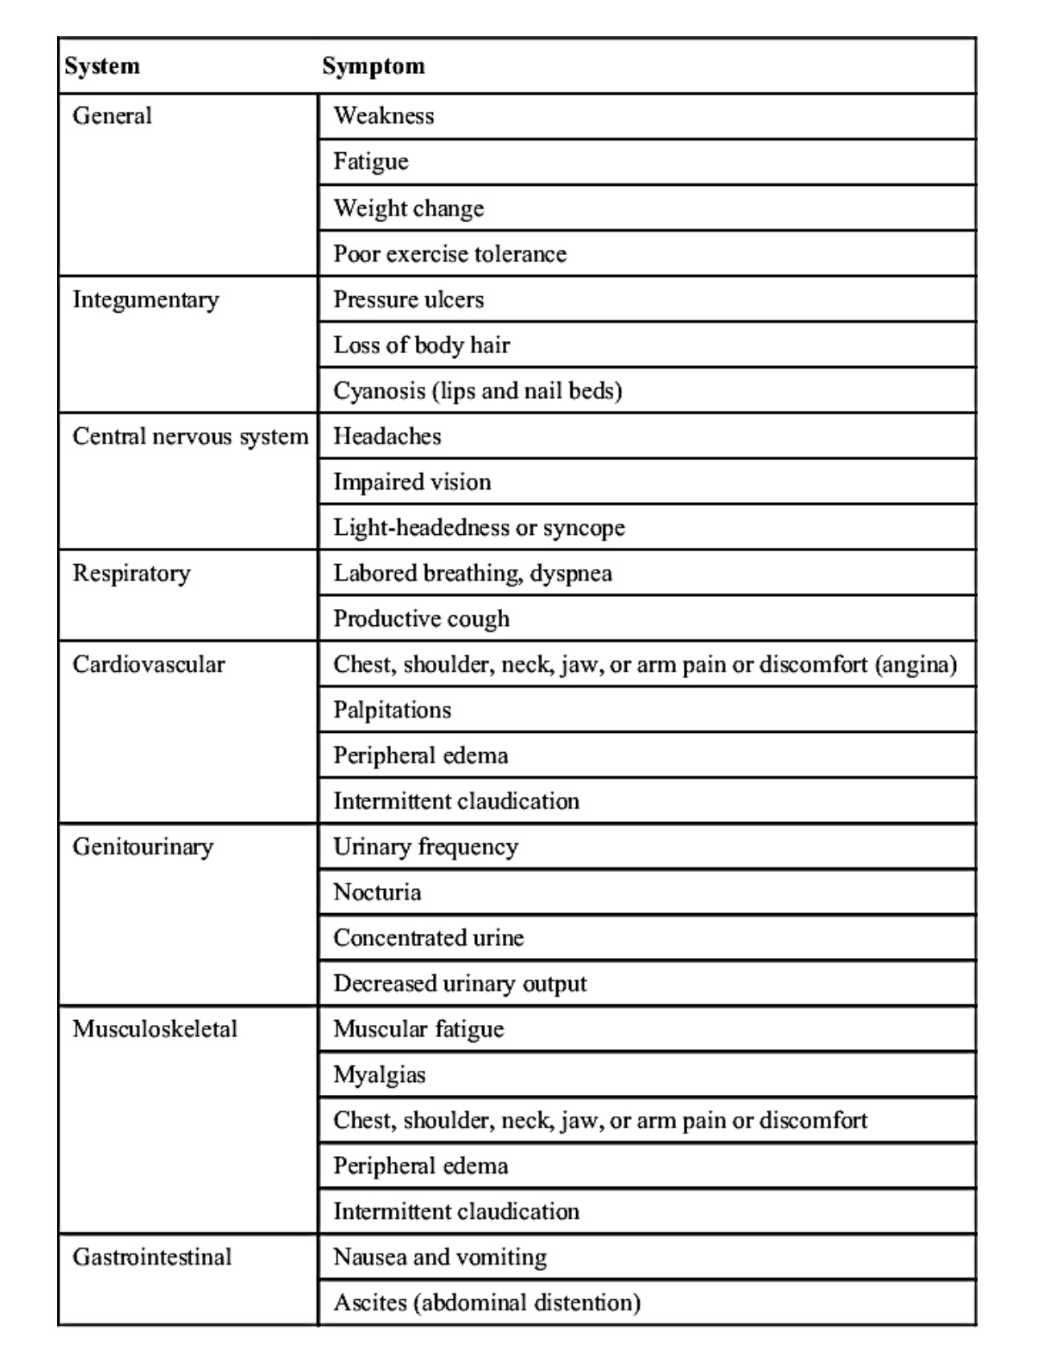

Slide 5
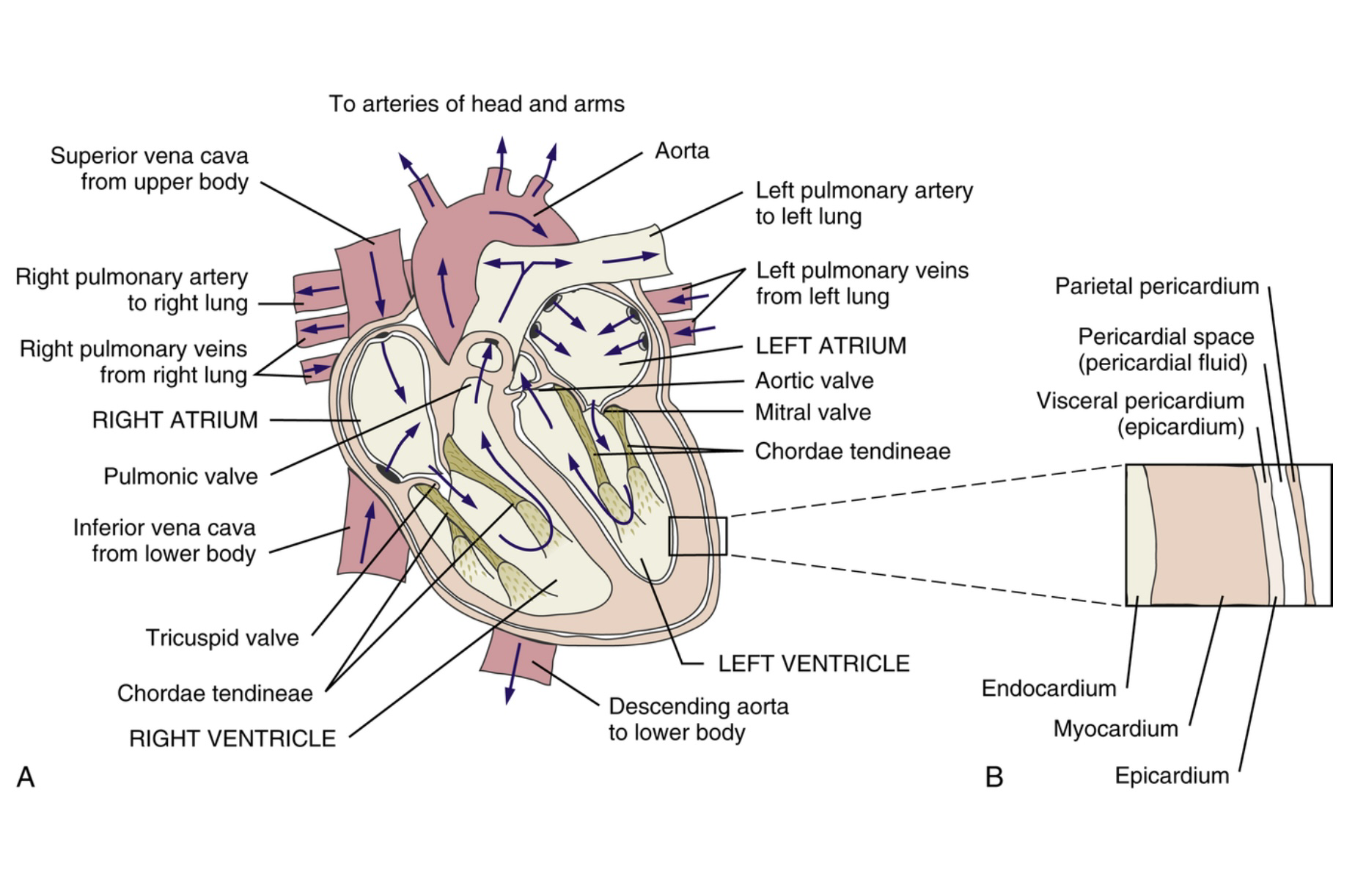

Slide 6
https://youtu.be/jBt5jZSWhMI?si=z7Uaa6BhJ97MGBJS
The four chambers of the heart are composed of cardiac muscle or myocardium.
The four chambers are the right and left atria in the upper part divided by the interatrial septum (IAS), and the right and left ventricles in the lower part divided by the interventricular septum (IVS) The role of the atria is to receive blood, and that of the ventricles to pump out blood.
The right atrium receives deoxygenated blood via the superior and inferior venae cavae (singular: vena cava). The superior vena cava collects deoxygenated blood from the upper body, and the inferior vena cava collects it from the lower body. Both venae cava empty into the right atrium and then into the right ventricle via the tricuspid valve. This valve is so called because it has three cusps or sections. The valve prevents backflow of blood into the right atria when the right ventricle contracts.

Slide 7
The right ventricle receives deoxygenated blood from the right atrium and contracts to pump this blood to the lungs for reoxygenation via the pulmonary artery through the pulmonary semilunar valve. This valve prevents backflow of blood into the right ventricle. The pulmonary artery is the only artery in the body that carries deoxygenated blood.
The left atrium is receiving newly oxygenated blood from the lungs via the pulmonary veins. Again the term is an anomaly because these veins carry oxygenated blood. The blood passes into the left ventricle via the mitral valve otherwise called the bicuspid valve, because it has two cusps. This valve prevents backflow of blood into the left atrium when the left ventricle contracts.The left ventricle has thick muscular walls, which enables blood to be pumped into the aorta and round the body. The aortic semilunar valve is located at the junction of aorta and left ventricle and prevents blood flow back into the ventricle.

Slide 8
Direction of blood flow through chambers and valves:
Deoxygenated blood enters via the SVC (no valve) and IVC (through valve of IVC) to the right atrium.
It passes through the tricuspid valve to the right ventricle.
Then, it passes through the pulmonary valve to the pulmonary arteries that carry deoxygenated blood to the lungs.
From the lungs, oxygenated blood is then carried via the pulmonary veins into the left atrium.
Oxygenated blood passes through the mitral valve into the LV.
Then, it passes through the aortic valve into the aortic arch to the systemic circulation.
The valves always open toward the next chamber to allow forward flow and close behind the contracting chamber to prevent backflow.
https://youtu.be/IS9TD9fHFv0

Slide 9
Coronary Arteries
The coronary arteries are a network of progressively smaller vessels that carry oxygenated blood to the myocardium. The right and left coronary arteries arise from the ascending aorta just beyond where the aorta leaves the left ventricle. These arteries and their branches supply all parts of the myocardium.
Coronary Veins
The coronary veins return deoxygenated blood from the myocardium back to the right atrium. The coronary venous circulation includes the coronary sinus, cardiac veins, and thebesian veins. The great cardiac vein, along with the small and middle cardiac veins, drain into the coronary sinus, emptying into the right atrium. The thebesian veins arise in the myocardium and drain into all chambers of the heart, but primarily into the right atrium and right ventricle.

Slide 10
Neural Control of the Heart
The functions of the heart are controlled by the cardiac control center in the medulla of the brain. Receptors in the walls of the aorta and carotid arteries called baroreceptors monitor changes in blood pressure and send impulses to the medulla that stimulate the sympathetic and parasympathetic nervous systems to adjust the rate and force of contractions in the heart.
The sympathetic influence is achieved by release of epinephrine and norepinephrine. Sympathetic nerves stimulate the chambers to beat faster and with greater force of contraction.
The parasympathetic influence is achieved via acetylcholine release from the vagus nerve. Parasympathetic nerves slow the heart rate primarily through their influence on the SA node.

Slide 11
Cardiac conduction system
The usual origin of nervous impulses to the rest of the heart is from the sinoatrial (SA) node located in the right atrium.
This SA node is known as the pacemaker because it sets the pace of contraction of the heart. The normal pace set is called the sinus rhythm and is approximately 70 beats per minute. This rate is affected by external factors, such as release of epinephrine in response to stress, or by the autonomic nervous system, resulting in a speeding up of the rhythm.
Impulses start at the SA node, spread over the surface of the atria causing contraction of the atria, and pass to the atrioventricular (AV) node in the base of the right atrium.The impulses pause slightly at the AV node and then pass into the ventricle through the bundle of His (AV bundle)to the Purkinje network, which stimulates both ventricles to contract.

Slide 12
Cardiac Cycle : (The cardiac cycle refers to the sequence of events that occur when the heart beats)
Atrial systole: The contraction (depolarization) of the right and left atria pushing blood into the ventricles.
Atrial diastole: The period between atrial contractions when the atria are repolarizing.
Ventricular systole: Contraction of the right and left ventricles pushing blood into the pulmonary arteries and aorta.
Ventricular diastole: The period between ventricular contractions when the ventricles are repolarizing.

Slide 13
Preload: Refers to the tension in the ventricular wall at the end of diastole ( end-diastolic volume at the beginning of systole). It reflects the venous filling pressure that fills the left ventricle during diastole. The amount of blood left in LV at the end of diastole. The greater the diastolic filling (preload), the greater the quantity of blood pumped.
Increased end-diastolic volume or preload influences the degree of stretch and the alignment of the myocardial muscle fibers. Optimal fiber length allows for good contractility of the heart, ejection of blood, and appropriate cardiac output (CO). As venous return increases during exercise, the preload volume increases to take advantage of the Frank-Starling law of the heart. This law states that stroke volume (SV) increases when there is increased venous return leading to increased ventricular filling, which in turn elongates the pre-contraction length of the myocardial cells and improves their contractile force.

Slide 14
Afterload: Refers to the forces that impede the flow of blood out of the heart, primarily the pressure in the peripheral vasculature, the compliance of the aorta, and the mass and viscosity of blood. The myocardial force the LV must generate during systole to overcome aortic pressure to open the aortic valve.
Stroke volume (SV): Refers to the volume of blood ejected by each contraction of the left ventricle. Normal SV ranges from 60 to 80 ml depending on age, sex, and activity.

Slide 15
Cardiac output (CO): The amount of blood pumped from the left or right ventricle per minute. It is equal to the product of stroke volume and heart rate. Normal CO for an adult male at rest is 4.5 to 5.0 L/min with women producing slightly less. CO can increase up to 25 L/min during exercise.
The cardiac output depends on heart rate (HR) and stroke volume (SV), which is the amount pumped from one ventricle during one contraction. The resting cardiac output is approximately 5 liters per minute and can be expressed by the following equation:
CO = SV X HR = 70 X 70 = 4,900 mL
Venous return: The amount of blood that returns to the right atrium each minute. This is similar in volume to the CO. Because the cardiovascular system is a closed loop, venous return must equal CO when averaged over time
Ejection fraction: Percentage of blood emptied from the ventricle during systole. The higher the percentage, the better the heart is contracting.

Slide 16
Ejection fraction (Ef) is the volume fraction of blood ejected from the ventricle during each heart contraction. The normal left Ef is about 58% of the SV.
Ejection fraction is a percentage of blood emptied from the ventricle during systole; a clinically useful measure of LV function.
(1) EF = stroke volume (SV)/left ventricular end diastolic volume (LVEDV).
(2) Normal EF averages >55%; the lower the EF, the more impaired the LV

Slide 17
Cardiac Cycle
The cardiac cycle is the normal alternating rhythm of contraction and relaxation of the heart muscle. Diastole is the relaxation phase and systole the contraction phase.
In diastole, both atria fill with blood while the AV (the mitral and tricuspid) valves are closed. Atrial pressure rises and opens the atrioventricular valves, causing blood to flow into the ventricles.
Systole begins with atrial contraction squeezing all the blood from the atria into the ventricles, causing the ventricles to be full. The next part of systole is when the ventricles start to contract, the pressure of blood in the ventricles closes the atrioventricular valves, and the atria relax. Next, the ventricles contract, causing increased pressure within the ventricles, which opens the aortic and pulmonary valves and pushes blood into the aorta and the pulmonary artery. After the blood has passed into the aorta and pulmonary artery, the aortic and pulmonary valves close, and diastole or relaxation is resumed.

Slide 18
The conduction of electrical impulses through the heart enables it to be monitored by an electrocardiogram (ECG). When electrodes are attached to the skin, the electric impulses of the heart can be recorded.
Atrial contraction is demonstrated by depolarization of the P wave, ventricular contraction by the large wave of depolarization in the ventricles or QRS wave. The third wave, or T wave, shows the repolarization of the ventricles during the recovery phase of the heartbeat. Because the normal graph produced on the ECG by the heart contraction is readily recognized, it is possible to detect abnormalities of the heart through the graph tracings. Such abnormalities are called arrhythmias and are used diagnostically for detecting heart diseases.

Slide 19
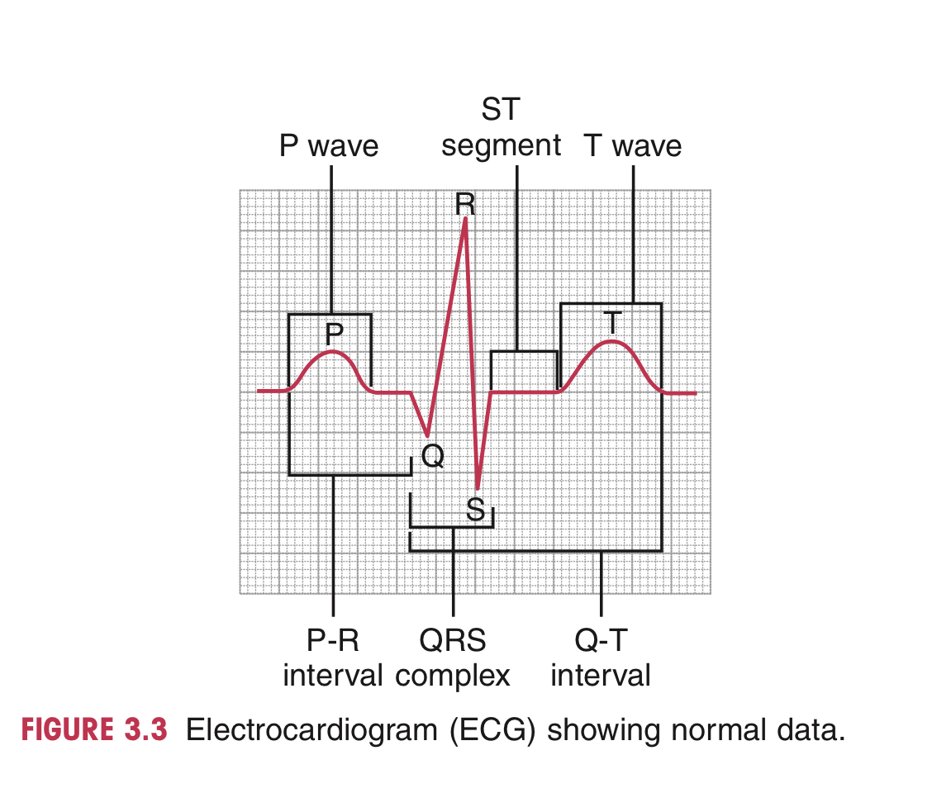
Normal Cardiac Cycle
1. Normal sinus rhythm.
2. P wave: Atrial depolarization (atrial contraction).
3. P-R interval: Time required for impulse to travel from atria through conduction system to Purkinje fibers.
4. QRS wave: Ventricular depolarization (ventricular contraction).
5. ST segment: Beginning of ventricular repolarization.
6. T wave: Ventricular repolarization.
7. QT interval: Time for electrical systole.

Slide 20
https://youtu.be/ocWk8zD8ZPk
https://youtu.be/nfVtAtJpjkQ
Selected EKG Abnormalities:
ST Elevation – new infarct or injury or pericarditis
ST Depression – may indicate ischemia if downsloping 2-3 mm
Inverted T wave – ischemia
Wide QRS – Bindle branch heart block affecting ventricles
Q Wave – seen in infarction
P wave different or Absent – atrial or ventricular arrhythmias
Premature Ventricular Contraction (PVC) – a disorder of rhythm that causes impulses to be discharged earlier or more frequently than normal. During exercise, if they occur at a rate of more than 5/min, occur in pairs or are multifocal (originate from more than one place in the heart), then this would be a concern.

Slide 21
Heart sounds video:
https://youtu.be/zNHI-l_c-ls

Slide 22
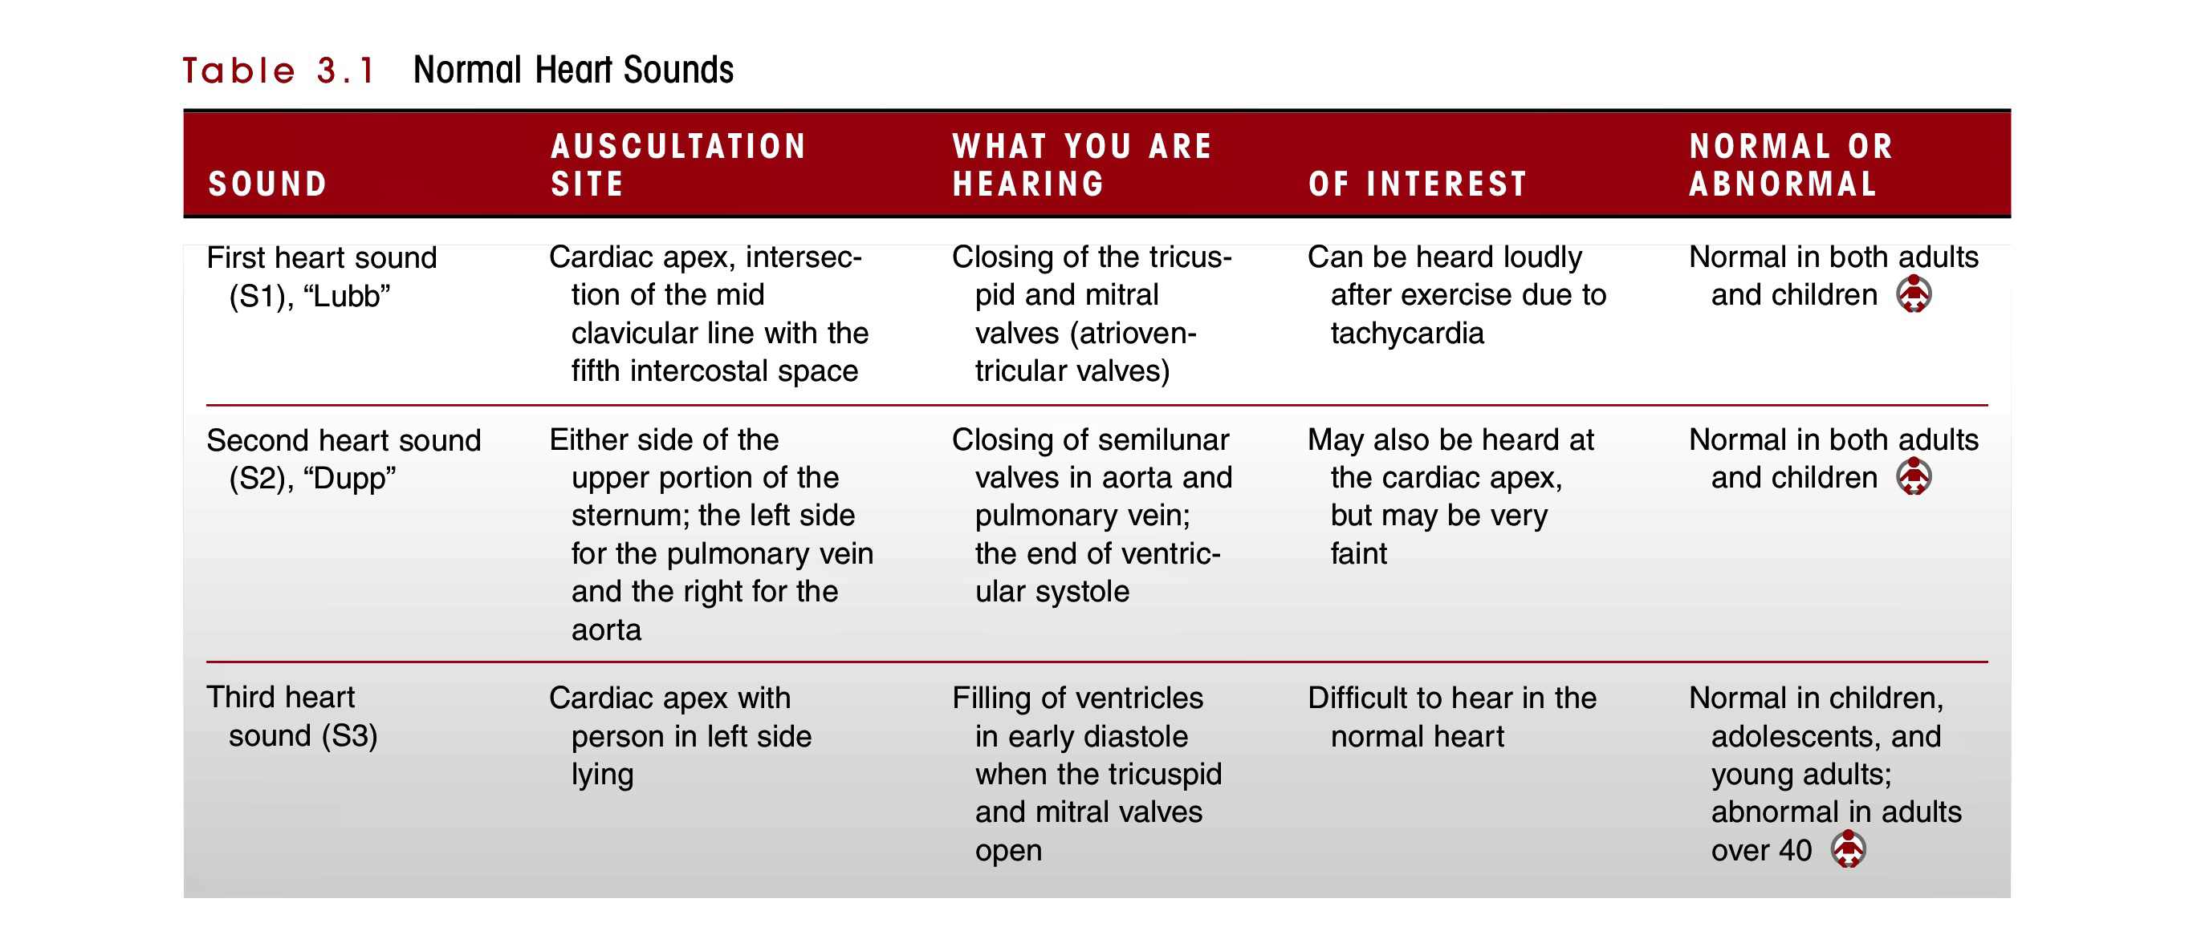

Slide 23
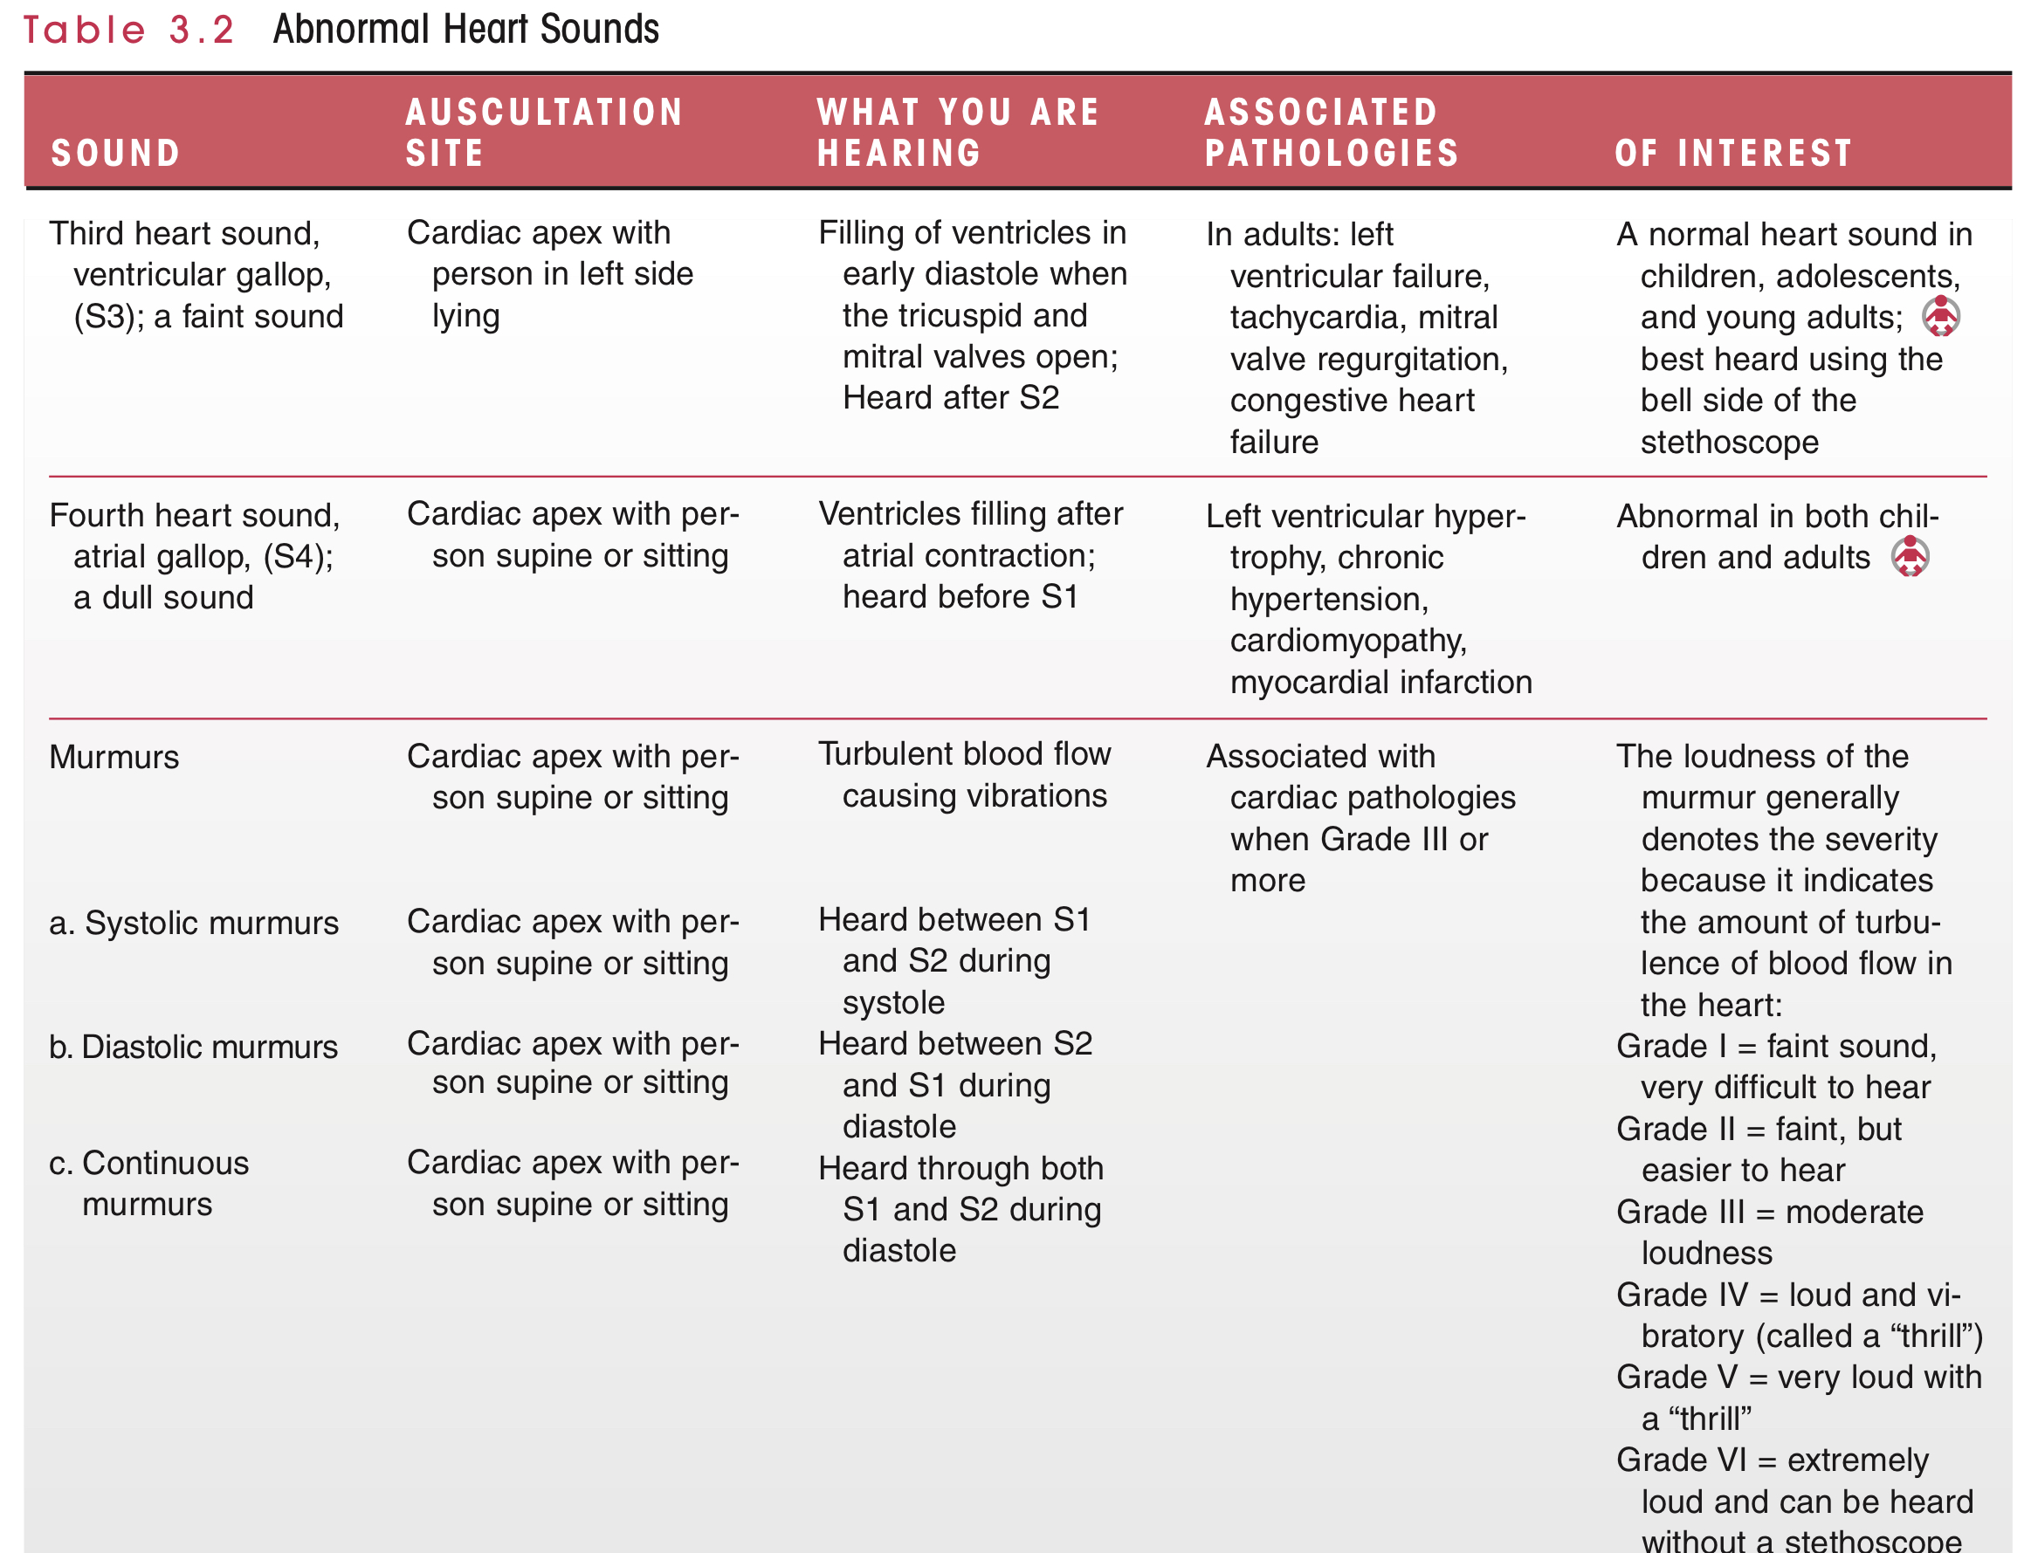

Slide 24
Auscultation of Heart Sounds
Procedure
The bell or diaphragm of the stethoscope is held directly on the patient’s bare skin with enough pressure to provide a skin seal while the patient breathes quietly through the nose.
Aortic area - 2nd intercostal space at the right sternal border
Pulmonic area - 2nd intercostal space at the left sternal border
Mitral area- 5th intercostal space, medial to the left mid clavicular line
Tricuspid area - 4th intercostal space at the left sternal border

Slide 25
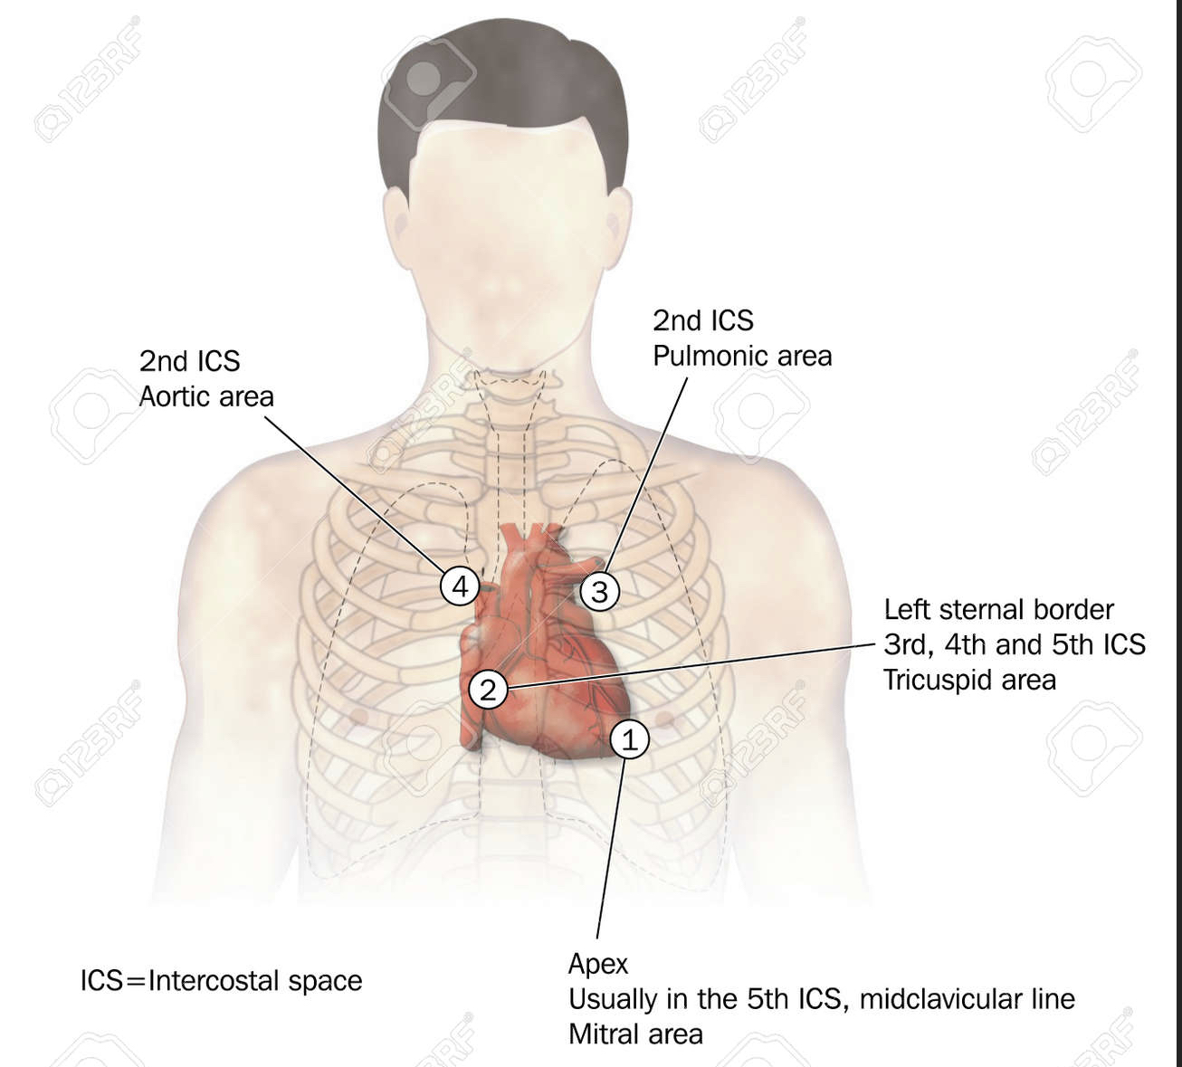

Slide 26
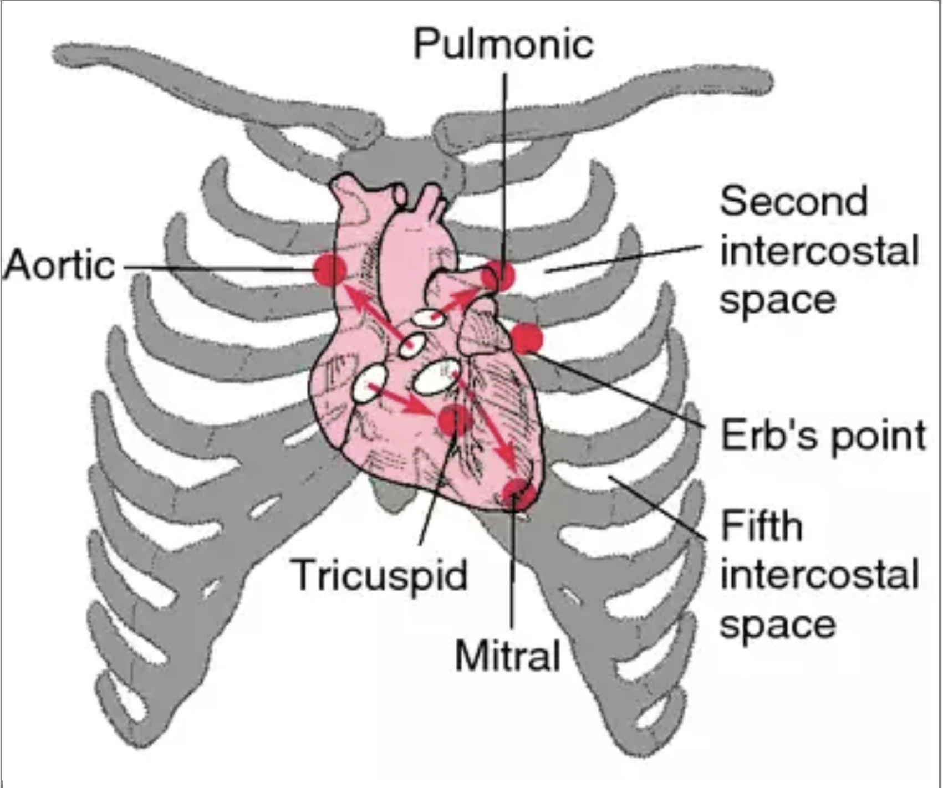

Slide 27
General signs and symptoms of cardiac disease
ATRIAL FIBRILLATION
Atrial fibrillation is an abnormal, involuntary contraction of the atria muscle, which causes an arrhythmia of the heart and a reduction of contraction of the ventricles.
The irregularity is caused by too many stimuli to the atrium, which causes an involuntary, rapid quivering of the atrial myocardium, resulting in ineffective pumping of blood into the ventricles.
The atrial myocardium goes into a state of trembling and is unable to function. The atria will quiver instead of beating in a coordinated rhythm.
Atrial fibrillation is detected through an ECG.

Slide 28
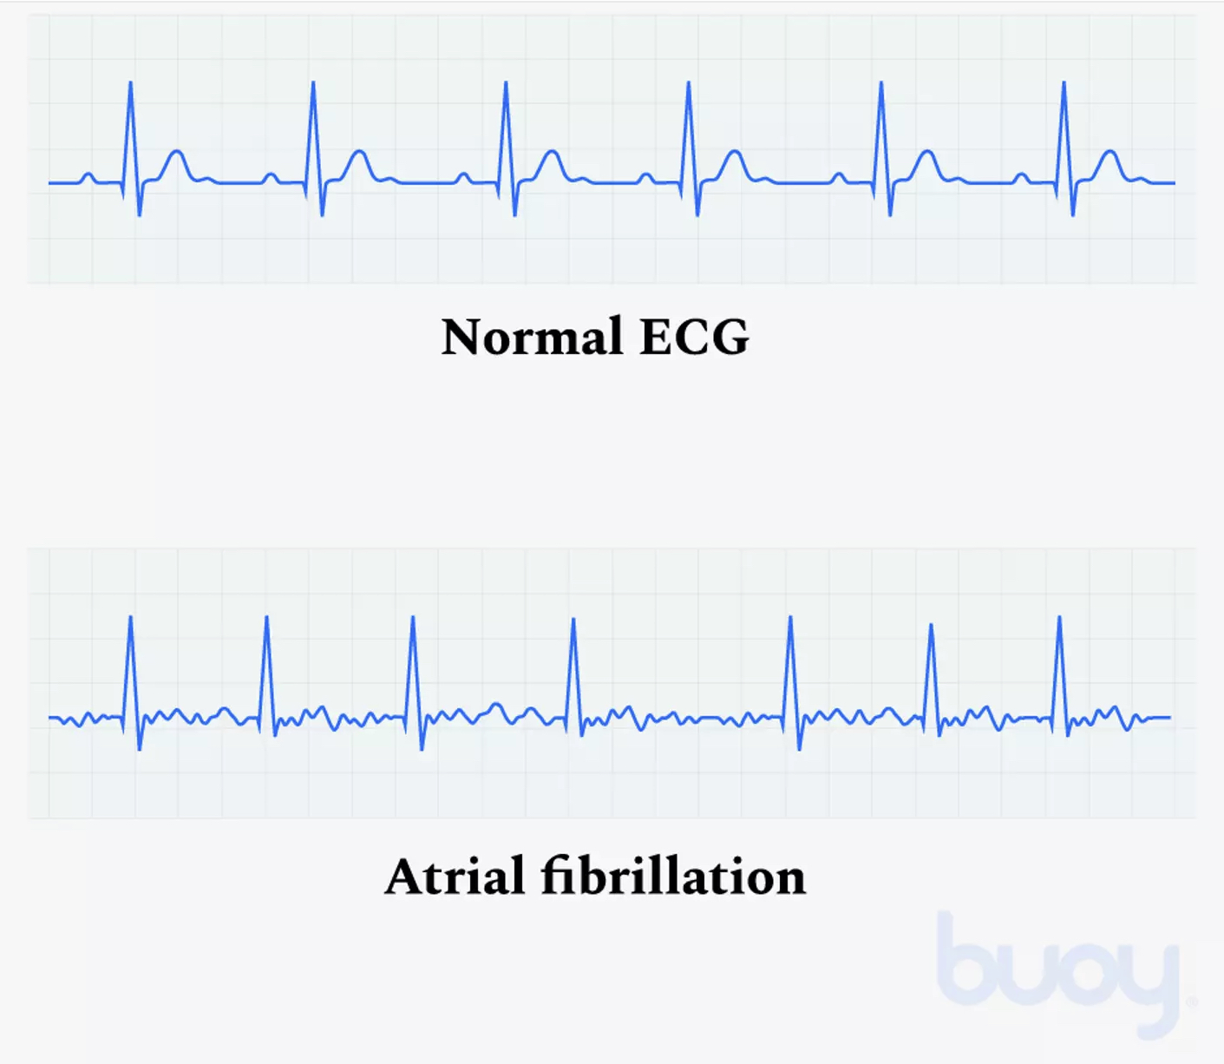

Slide 29
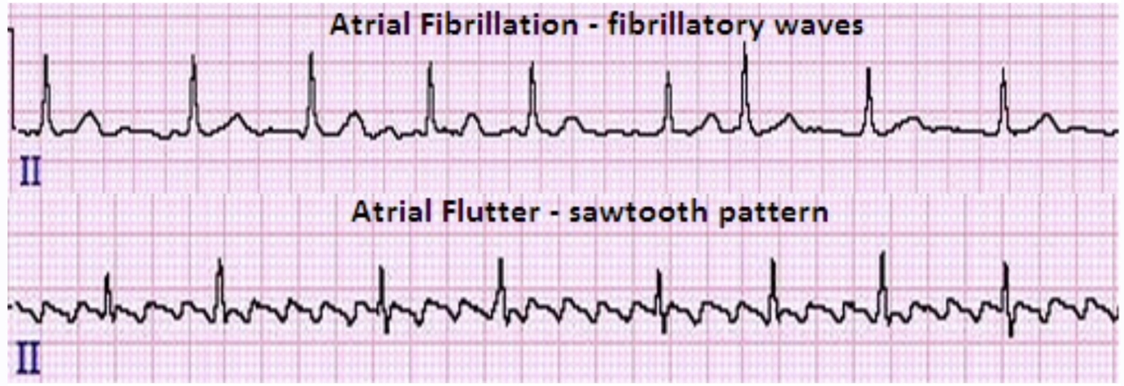

Slide 30
Atrial flutter: arrhythmia in which atria beat too rapidly, but in regular pattern
Atrial fibrillation: extremely serious arrhythmia characterized by abnormal quivering or contraction of heart fibers.
No recognizable P waves, but irregular undulating baseline represents atrial fibrillatory waves. Rate/Rhythm: Atrial rate of 300 to 600/min, irregular RR interval (RR interval is the time from one beat to the next). P waves may appear chaotic. RR interval is irregular with no pattern. Due to a loss of atrial kick, described as the normal volume and blood flow to the ventricles, decreased CO can occur in some patients.

Slide 31
The immediate treatment for atrial fibrillation is the use of anti-arrhythmic drugs. Digitalis is used on a regular basis to slow down the atrial contractions and thus restore them to functional contraction.
Seen with hypertension, rheumatic heart disease, and cardiomyopathy, cardiac failure, post MI, COPD, diabetes.
Drug-related problems such as illicit drug abuse or digoxin toxicity.
If the PTA suspects that the patient is in atrial fibrillation, the supervising PT should be consulted immediately. In severe cases, when the patient becomes unconscious, cardiopulmonary resuscitation (CPR) may be required.
S/S: palpitation, arrhythmias, dyspnea, chest discomfort, dizziness, weakness, anxiety from awareness of a rapid and/ or irregular heartbeat.

Slide 32
CYANOSIS
Cyanosis is either central or peripheral.
Central cyanosis occurs more with pulmonary diseases in which there is an oxygen saturation level of less than 80%, meaning there is poor oxygen uptake by the tissues. In central cyanosis the lips, tongue, ears, and other mucous membranes have a bluish tinge.
Peripheral cyanosis is associated more with cardiac diseases in which there is low cardiac output. Indications of peripheral cyanosis include blueness in the fingertips, nail beds, toes, and the nose.

Slide 33
DYSPNEA
Dyspnea (shortness of breath), particularly dyspnea on exertion (DOE), is often associated with heart conditions but is also exhibited with allergic responses such as asthma and in people who are obese or in poor physical condition.
If dyspnea symptoms are severe or occur at rest, patients should be referred to a physician, regardless of whether they happen to be a cardiac patient.
The PTA needs to carefully observe the patient for signs of dyspnea during PT interventions and require periods of rest if necessary.

Slide 34
EDEMA
Edema is a side effect of cardiac disease. Edema is usually manifested as swelling of the hands, feet, ankles, and abdomen and is often accompanied by shortness of breath, dyspnea, and fatigue.
If all these symptoms occur together, there is a high probability of a cardiac disease such as congestive heart failure (CHF).
BILATERAL EDEMA (pitting edema) is associated with CHF.
Unilateral edema-local factors, thrombophlebitis, PVD.

Slide 35
Grading scale for edema
1+ Mild, barely perceptible indentation; < ¼ inch pitting; up to 2 mm
2+ Moderate, easily identified depression; returns to normal within 15 seconds; ¼-½ inch pitting; 2-4 mm depression
3+ Severe, depression takes 15-30 seconds to rebound; ½-1 inch pitting; 4-6 mm depression
4+ Very severe, depression lasts for > 30 seconds or more;> 1 inch pitting; 6-8 mm depression

Slide 36
FATIGUE
If the fatigue occurs with other symptoms previously described such as dyspnea, headache, chest pain, or arrhythmias, it is probably due to the cardiac condition, and the exercise or activity should be stopped immediately, the patient instructed to rest, and the PT consulted.

Slide 37
HEART BLOCK
Heart block occurs when the normal neurological impulses that stimulate the heart to contract are interrupted. A complete heart block occurs when the impulses do not reach the ventricles, causing the heart to"skip"a beat
Patients with this condition usually must have a cardiac pacemaker surgically inserted to regulate their heart rhythm.
3 degrees of heart block are recognized:
the complete or third-degree block where impulses are blocked;
the second-degree block in which electrical impulses are occasionally obstructed
the first-degree block in which electrical impulses are slowed but do not interfere with the heart contraction.

Slide 38
INTERMITTENT CLAUDICATION
Intermittent claudication is a symptom of arterial disease that can be associated with cardiac conditions. This condition occurs most often as a result of disease in the popliteal artery and causes severe pain in the calf during walking activities, exercise, or prolonged standing.
Rest alleviates the pain, but as the disease process progresses, the symptoms become worse and occur more frequently. The pain of intermittent claudication is due to insufficient blood supply to the muscles affected by the diseased artery.

Slide 39
PAIN
Pain in patients with cardiac conditions can be felt in referred areas such as the left shoulder as well as over the left and central chest areas and into the left neck and jaw.
The heart is supplied by nerves from the fifth and sixth cervical spinal segments, and thus pain in the heart can be transferred to dermatomes (areas of skin supplied by a nerve root) supplied by the same nerve supply. The C6 dermatome covers the thumb side of the hand and forearm. The dermatome for C5 lies over the deltoid muscle.

Slide 40
PALPITATIONS
Palpitations are arrhythmias or deviations from the normal heart rhythm. A person may describe a pounding of the heart or a sudden awareness of the heart changing beat pattern.
People are not normally aware of their heart beating, but when it beats more rapidly or more strongly, they may become acutely aware of these changes. Palpitations may occur with serious conditions such as coronary artery disease (CAD) or less serious ones such as mitral valve incompetence.

Slide 41
PREMATURE VENTRICULAR CONTRACTIONS
Arrhythmias are abnormalities in the rhythm of the heart caused by a ventricular lesion. They are potentially life threatening and require immediate attention from the physician.
Premature ventricular contraction (PVC) is the most common arrhythmia and is characterized on the ECG by a premature beat of the ventricle.
PVCs are seen within the normal population after caffeine use, smoking, anxiety, or drinking alcohol. PVCs are also evident on ECG after a myocardial infarction (MI) or in other cardiac conditions that cause ischemia of heart tissue, such as CAD or CHF. Maybe caused by electrolyte imbalances, chronic lung disease or hypoxemia.
Treatment: depends on the cause , frequency, severity of PVC. May progress to lethal VT (ventricular tachycardia) or Vfib.

Slide 42
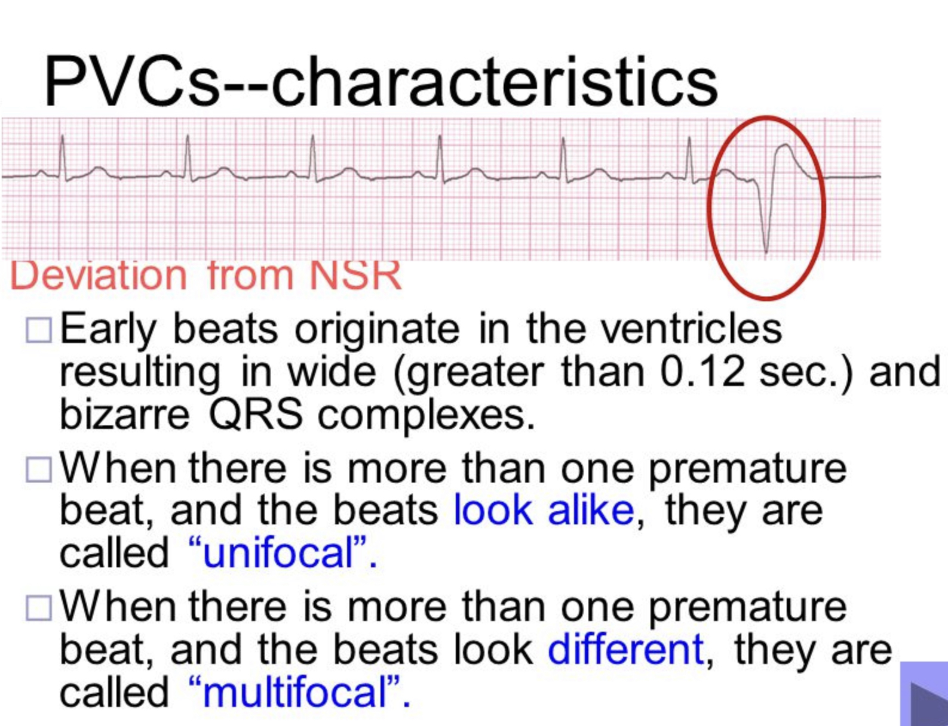

Slide 43
REDUCED EJECTION FRACTION
In pathologies where cardiac muscle function is affected, there is a reduction in the ability of the heart to pump blood to the body.
The reduction in effectiveness of the left ventricle reduces the ejection fraction of the heart and consequently reduces the ability of the patient to perform aerobic activities.
Pathologies in which a reduced ejection fraction may be a significant factor include CHF, hypertension, CAD, and MI.

Slide 44
SYNCOPE
Syncope is caused by reduction of oxygen to the brain that results in feelings of lightheadedness or episodes of fainting.
When it is caused by a cardiac condition such as an arrhythmia or CAD, it is called cardiac syncope.
If the PTA is working with a patient who faints or experiences periods of light headedness or headaches, the PT, nurse, or physician should be alerted immediately.

Slide 45
VENTRICULAR FIBRILLATION
Ventricular fibrillation is serious and leads to complete loss of muscle contractions in the heart.
This phenomenon occurs in MI and, if not treated immediately, will result in death.
The heart muscle is kick-started by use of a defibrillation machine, which stops the heart and starts it again. This electrical shock given to the heart aims to override the abnormal rhythm, stop the heartbeat, and stimulate are turn to the normal rhythm.
All medical personnel including PTAs are required to be educated in the administration of CPR and the defibrillator machine.

Slide 46
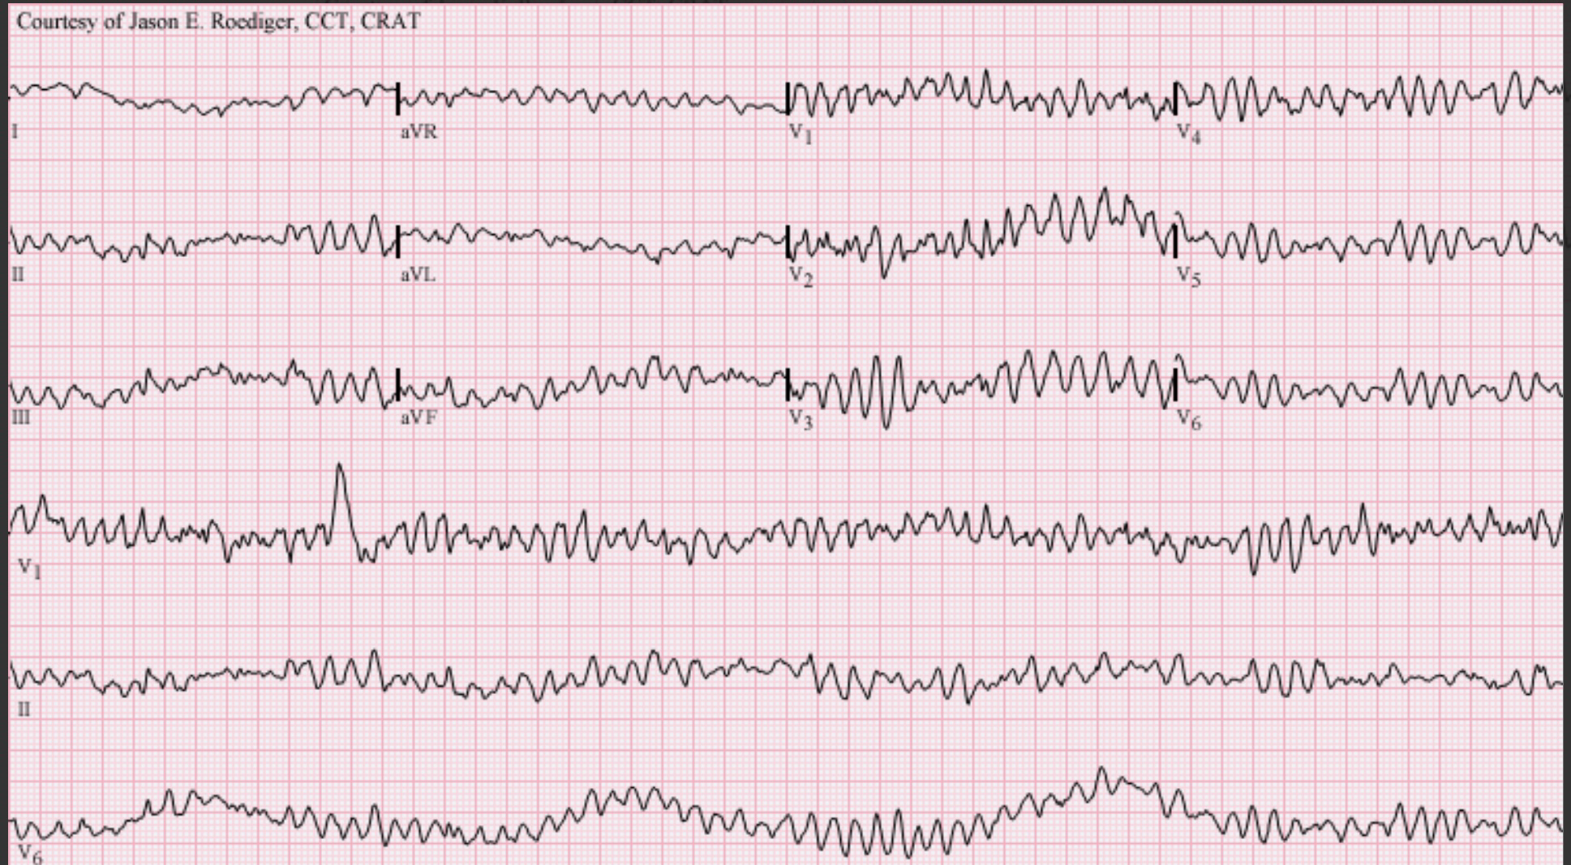
Ventricular fibrillation

Slide 47
Common causes of Vfib:
Ischemia, acute infarction, CAD
Respiratory failure (hypoxia), massive PE.
Electric shock.
Cardiac pacing.
Heart block (advanced)
Treatment:
Defibrillation followed by CPR, supplemental oxygen, and medications.
https://youtu.be/kVhnNGlgIOU

Slide 48
Diagnostic Tests Performed for Cardiac Patients
Ambulatory Electrocardiography.
Also known as Holter monitoring, ECG electrodes are placed on the chest and attached to a small battery-operated recording monitor carried in a pocket or in a small pouch around the neck.
The ECG is recorded for 24 to 48 hours or longer to evaluate cardiac rhythm, the efficacy of medications, and pacemaker function. It is then correlated with a diary of the patient’s symptoms and activities.
Angiography
A radiologic examination that injects a contrast medium into the blood vessels. Coronary angiograms are part of the group of procedures known as cardiac catheterization. An angiogram can show the location of plaques in the coronary arteries and the extent of occlusion.

Slide 49
Cardiac Catheterization
A thin catheter inserted into an artery in the leg or arm is advanced to the coronary arteries where a contrast dye is injected. The test can evaluate narrowing or occlusion of the coronary arteries and measure blood pressure in the heart and oxygen in the blood.
Computed Tomography (CT scan)
CT scan is a diagnostic test that uses an x-ray machine that rotates around a patient lying on a table. A computer processes the information from the scanner and creates a picture of the organ and surrounding structures. The pictures are slices of the body called tomograms and each picture is called a computed tomograph.

Slide 50
Echocardiography
Echocardiogram uses high frequency sound waves non-invasively to evaluate the functioning of the heart via real time images. An echocardiogram can provide information on the size and function of the ventricles, thickness of the septums, and function of the walls, valves, and chambers of the heart.
Fluoroscopy
A continuous x-ray procedure that shows the heart and lungs. Because fluoroscopy involves a relatively high dose of radiation, it has been largely replaced by echocardiography and other diagnostic tests. It is still a component of cardiac catheterization and electrophysiological testing.

Slide 51
Alpha Adrenergic Antagonist Agents
Action: reduce peripheral vascular tone. This action causes dilation of arterioles and veins and decreases blood pressure.
Indications: hypertension
Side effects: dizziness, palpitations, orthostatic hypotension, drowsiness
Implications for PT: Use caution when rising from a sitting or lying position due to the risk of dizziness and/or orthostatic hypotension. Closely monitor patient during exercise.
Examples: Cardura, Minipress

Slide 52
Angiotensin-Converting Enzyme (ACE) Inhibitor Agents
Action: ACE inhibitor agents decrease blood pressure and afterload by suppressing the enzymes.
Indications: hypertension, congestive heart failure
Side effects: hypotension, dizziness, dry cough, hyperkalemia, hyponatremia
Implications for PT: Avoid sudden changes in posture due to the risk of dizziness and fainting from hypotension.
Patients with heart failure should avoid rapid increases in physical activity.
Examples: Capoten, Vasotec

Slide 53
Anticoagulant Agents
Action: Anticoagulant agents reduce clotting and prevent thrombus formation
Indications: coronary artery bypass graft surgery, prevention of venous thromboembolism and cardio embolic events in patients with atrial fibrillation and prosthetic heart valves
Side effects: hemorrhage, increased risk of bleeding, gastrointestinal distress with oral medication.
Implications for PT: A therapist must be careful to avoid injury secondary to the risk of excessive bleeding or bruising. Patient education regarding common side effects is also indicated to protect the patient.
Examples: Heparin, Coumadin

Slide 54
Antihyperlipidemia Agents
Action: There are five categories of lipid-modifying agents. The most commonly used drugs, the statins, inhibit enzyme action in cholesterol synthesis, break down low density lipoproteins, decrease triglyceride levels, and increase HDL levels.
Indications: hyperlipidemia, atherosclerosis, prevent coronary events in patients with existing coronary disease, diabetes or peripheral vascular disease
Side effects: headache, gastrointestinal distress, myalgia, rash
Implications for PT: Aerobic exercise can increase high density lipoproteins and maximize the effects of drug therapy.
Examples: Lipitor, Zocor

Slide 55
Antithrombotic (Antiplatelet) Agents
Action: Antithrombotic agents inhibit platelet aggregation and clot formation.
Indications: post-myocardial infarction, atrial fibrillation, prevent arterial thrombus formation
Side effects: hemorrhage, thrombocytopenia, potential liver toxicity, gastrointestinal distress
Implications for PT: A therapist must be careful to avoid injury secondary to the risk of excessive bleeding. Patient education regarding common side effects is also indicated to protect the patient.
Examples: Bayer, Plavix

Slide 56
Beta Blocker Agents (Beta-Adrenergic Blocking Agents)
Action: Beta blocker agents decrease the myocardial oxygen demand by decreasing heart rate and contractility by blocking ß-adrenergic receptors.
Indications: hypertension, angina, arrhythmias, heart failure, migraines, essential tremor
Side effects: bradycardia, cardiac arrhythmias, fatigue, depression, dizziness, weakness, blurred vision
Implications for PT: Heart rate and blood pressure response to exercise will be diminished. Rate of perceived exertion may be used to monitor exercise intensity. Closely monitor patients during positional changes due to an increased risk for orthostatic hypotension.
Examples: Tenormin, Lopressor

Slide 57
Calcium Channel Blocker Agents
Action: Calcium channel blocker agents decrease the entry of calcium into vascular smooth muscle cells resulting in diminished myocardial contraction, vasodilation, and decreased oxygen demand of the heart.
Indications: hypertension, angina pectoris, arrhythmias, congestive heart failure.
Side effects: dizziness, headache, hypotension, peripheral edema
Implications for PT: Heart rate and blood pressure response to exercise will be diminished. Monitor patient closely when moving to an upright position secondary to dizziness and/or orthostatic hypotension. Observe the patient for signs and symptoms of congestive heart failure such as worsening peripheral edema, dyspnea or weight gain.
Examples: Procardia, Cardizem

Slide 58
Diuretic Agents
Action: Diuretic agents increase the excretion of sodium and urine. This causes a reduction in plasma volume which decreases blood pressure.
Indications: hypertension, edema associated with heart failure, pulmonary edema, glaucoma.
Side effects: dehydration, hypotension, electrolyte imbalance, polyuria, increased low-density lipoproteins, arrhythmias
Implications for PT: Positioning changes can increase the risk of dizziness and falls due to decreased blood pressure. Monitor patients closely for signs and symptoms of electrolyte imbalance and muscle weakness or cramping.
Examples: Furosemide, Diuril, Lasix

Slide 59
Nitrate Agents
Action: Nitrate agents decrease ischemia through smooth muscle relaxation and dilation of peripheral vessels.
Indications: angina pectoris
Side effects: headache, dizziness, orthostatic hypotension, tachycardia, nausea, vomiting
Implications for PT:Patients must be educated to come to a standing position slowly to minimize the risk of orthostatic hypotension. Sublingual administration of nitroglycerin is the preferred method to treat an acute angina attack.
Examples: Nitrostat, Nitroglycerin

Slide 60
Thrombolytic Agents
Action: Thrombolytic agents facilitate clot dissolution through conversion of plasminogen to plasmin. Plasmin breaks down clots and allows occluded vessels to reopen to maintain blood flow
Indications: acute myocardial infarction, pulmonary embolism, ischemic stroke, arterial or venous thrombosis
Side effects: hemorrhage (specifically intracranial in certain populations), allergic reaction, cardiac arrhythmia
Implications for PT: Therapists must be careful to avoid situations that may cause trauma due to altered clotting activity.
Examples: Kinlytic, Activase

Slide 61
Medical procedure for heart and vascular diseases
Balloon Angioplasty
Angioplasty involves temporarily inserting a small balloon-tipped catheter into a stenotic artery and expanding the balloon at the site of blockage to help widen a narrowed artery.
Angioplasty is usually combined with implantation of a small metal coil called a stent in the narrowed artery to help prop it open and decrease the chance of restenosis.

Slide 62
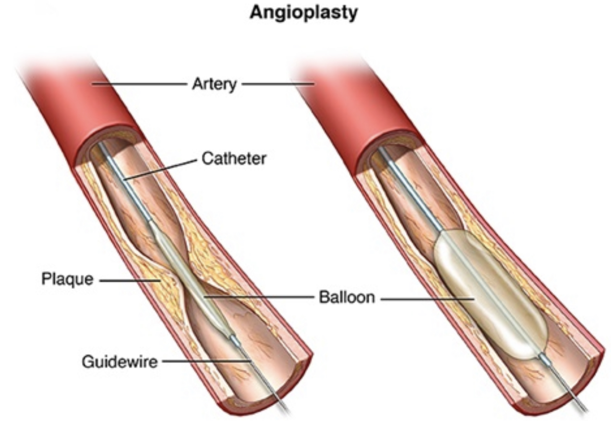

Slide 63
Cardiac Pacemaker
A pacemaker is a surgically implanted battery-powered device placed under the skin, usually in the left anterior chest wall.
Pacemakers are a standard treatment for conditions affecting the electrical conduction system including a slow heart rate and arrhythmias. By preventing a slow heart rate, pacemakers can treat fatigue, lightheadedness, and fainting.

Slide 64
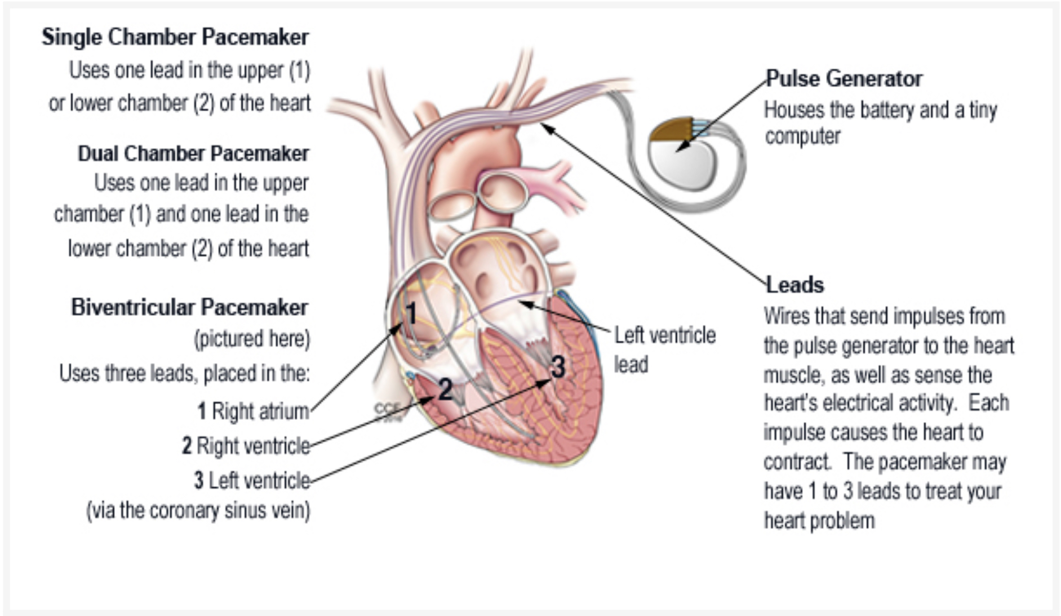

Slide 65
Coronary Artery Bypass Graft Surgery (CABG)
CABG surgery is performed to treat coronary arteries that are narrowed or occluded in an attempt to revascularize the myocardium. In this procedure, blood is rerouted around the affected artery joining the patient's own saphenous vein, internal thoracic/mammary artery, or radial artery to connect the affected artery above and below the occlusion.

Slide 66


